Slide 1

Comparison of RNAseq quantification tools in measuring gene expression of Ambystoma mexicanum limb Blastema
Nick Rose and Jimin Park
BME 237 Final Project Presentation
June 8, 2022

Slide 2
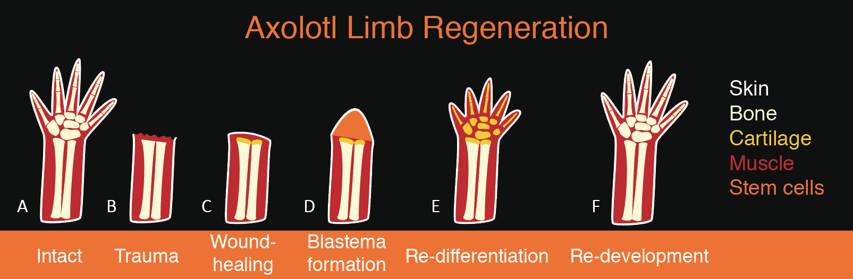
Axolotl (Ambystoma mexicanum)
Axolotls have the ability to regenerate limbs and heal wounds scarlessly
This is facilitated in part by their ability to transition differentiated cells back into progenitor stem cells upon injury
Objective: compare the gene expression levels of axolotl limb buds to control forelimb samples, identifying discrepancies; then run similar pipelines on additional software to compare tool accuracy.
https://sitn.hms.harvard.edu/flash/2018/regeneration-axolotl-can-teach-us-regrowing-human-limbs/

Slide 3

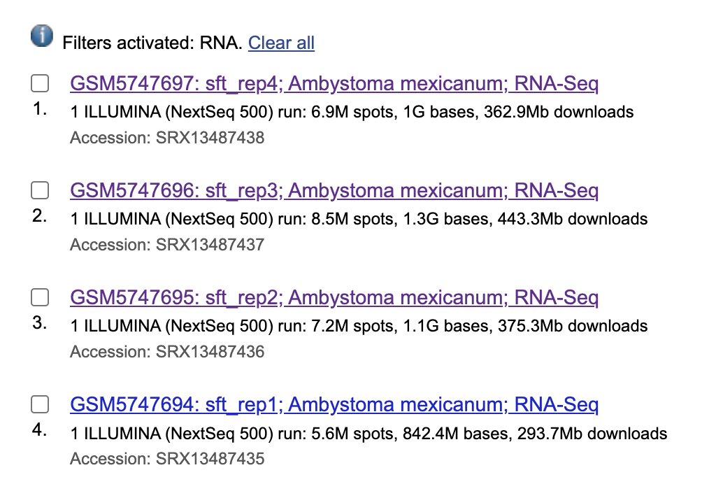

Methods: tools
3 Healthy samples vs. 3 Damaged limb samples
STAR + htseq-count
DESeq2
RNA-seq reads
(fastq)
UCSC Genome Browser
Salmon
edgeR
Kallisto
Differential Expression Analysis
Gene Identification
Obtain data
Quantification

Slide 4
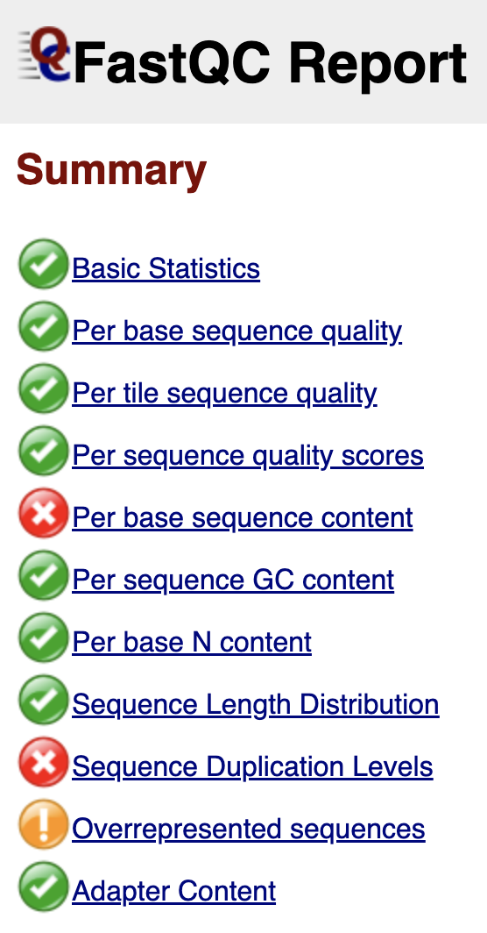
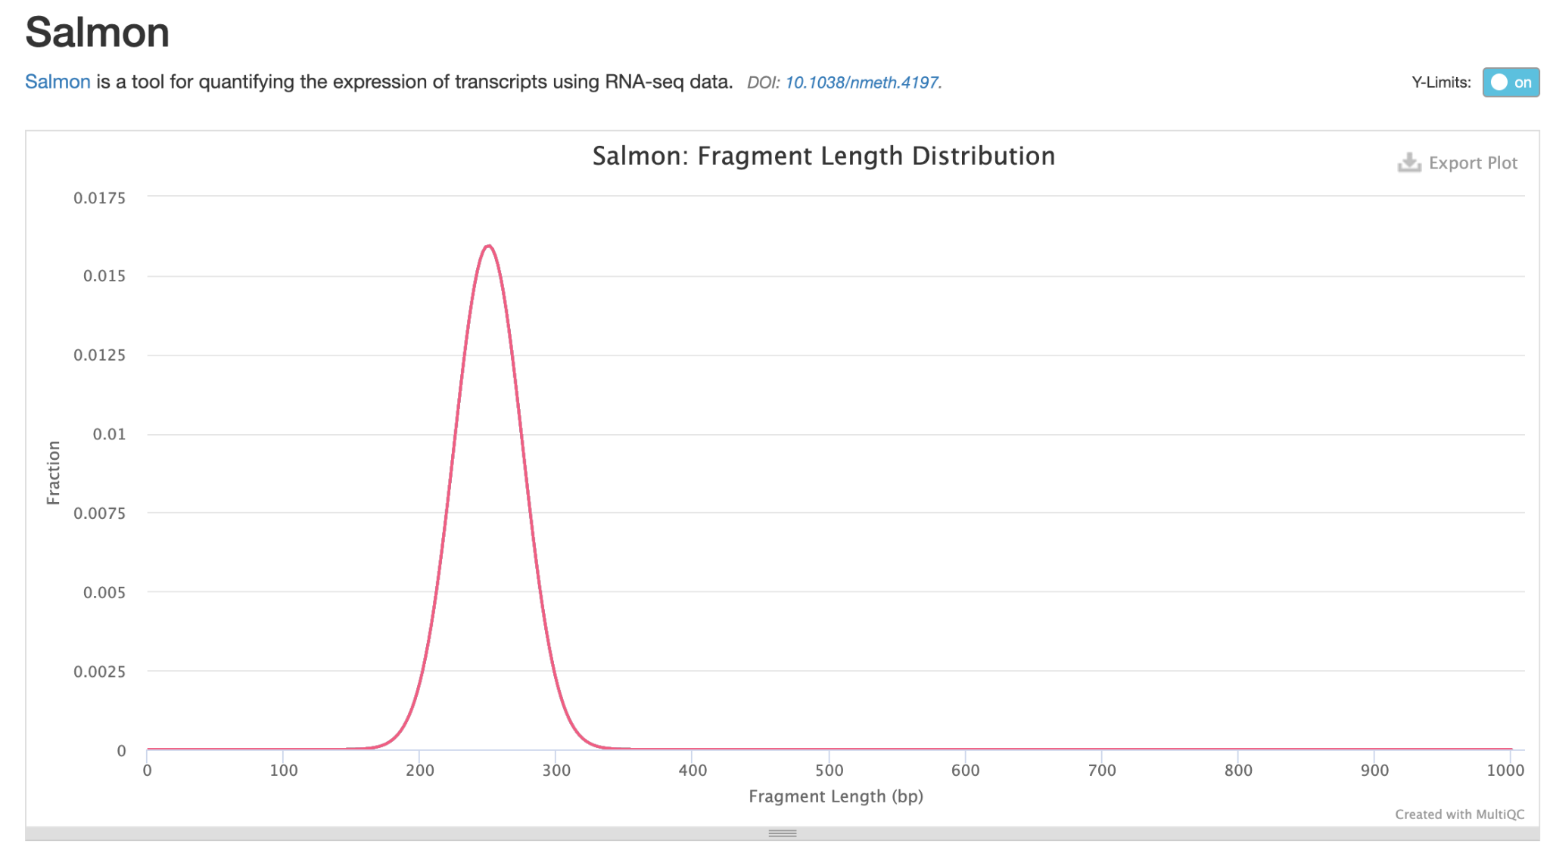
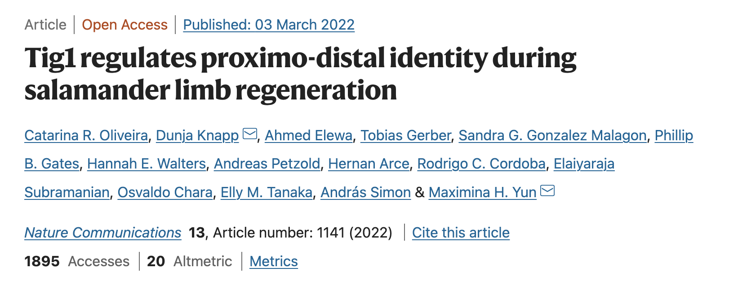
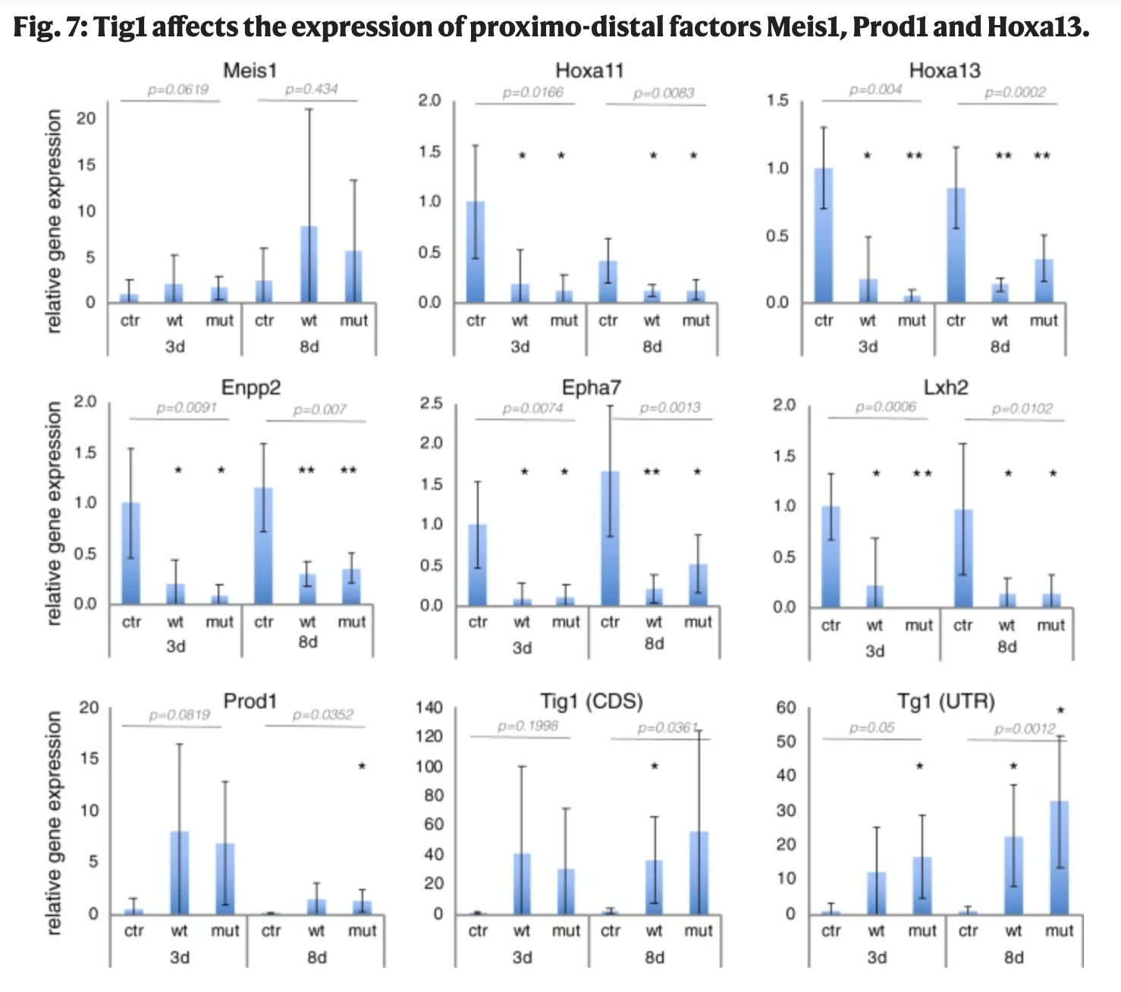
Methods: benchmarks and QC
Quality Control:
FastQC on all 6 fastq files
MultiQC on output files
Negative Control Analysis:
DESeq2 on a randomized set of samples
Benchmark:
Use qPCR data from paper on specific genes to compare to our differentially expressed genes

Slide 5
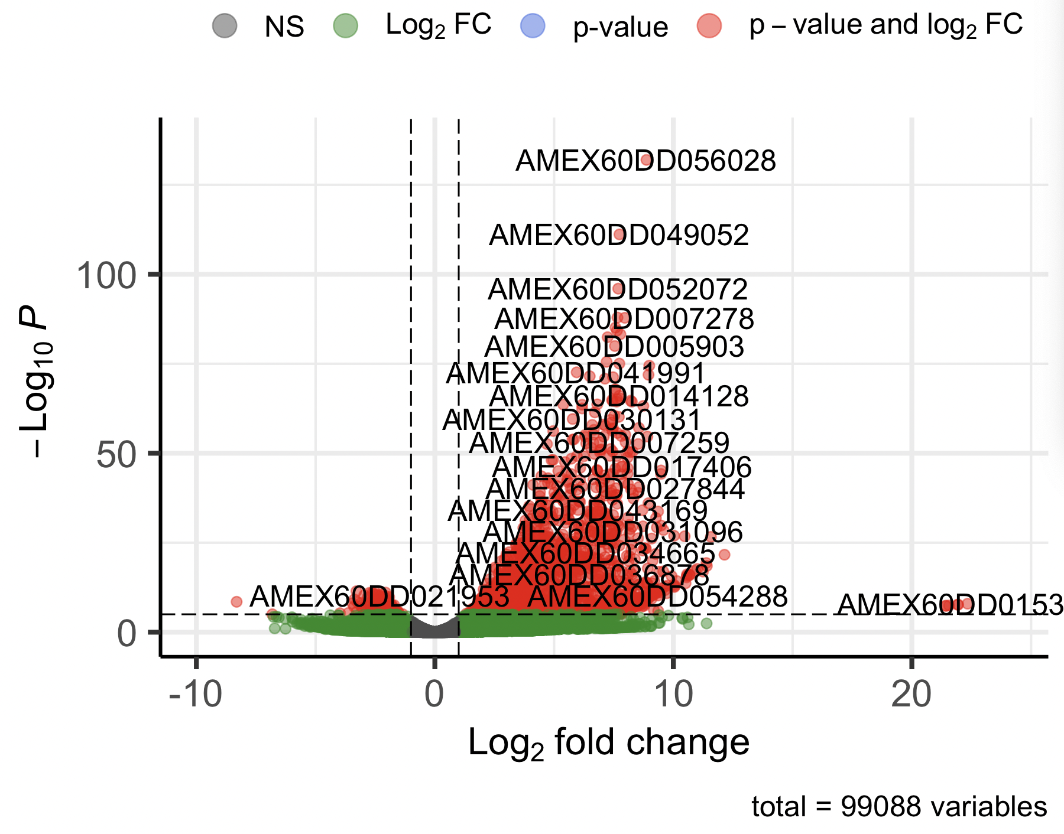
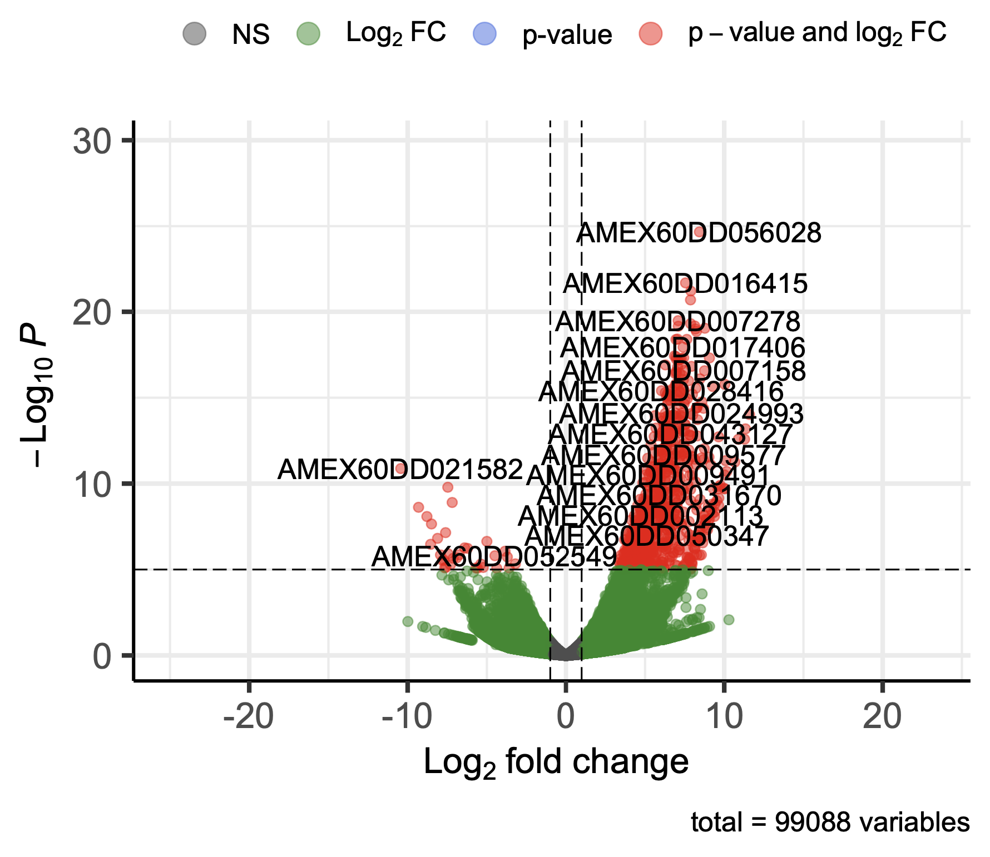
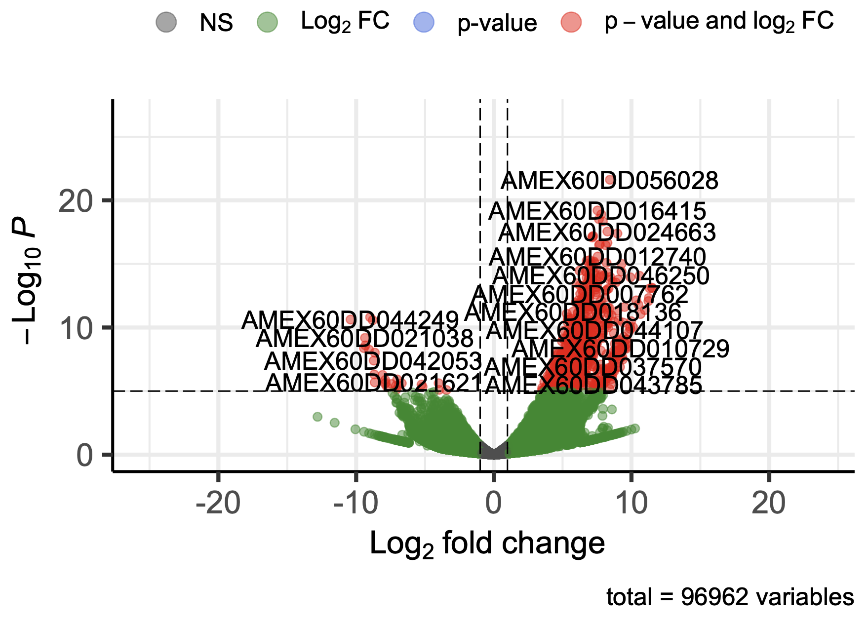
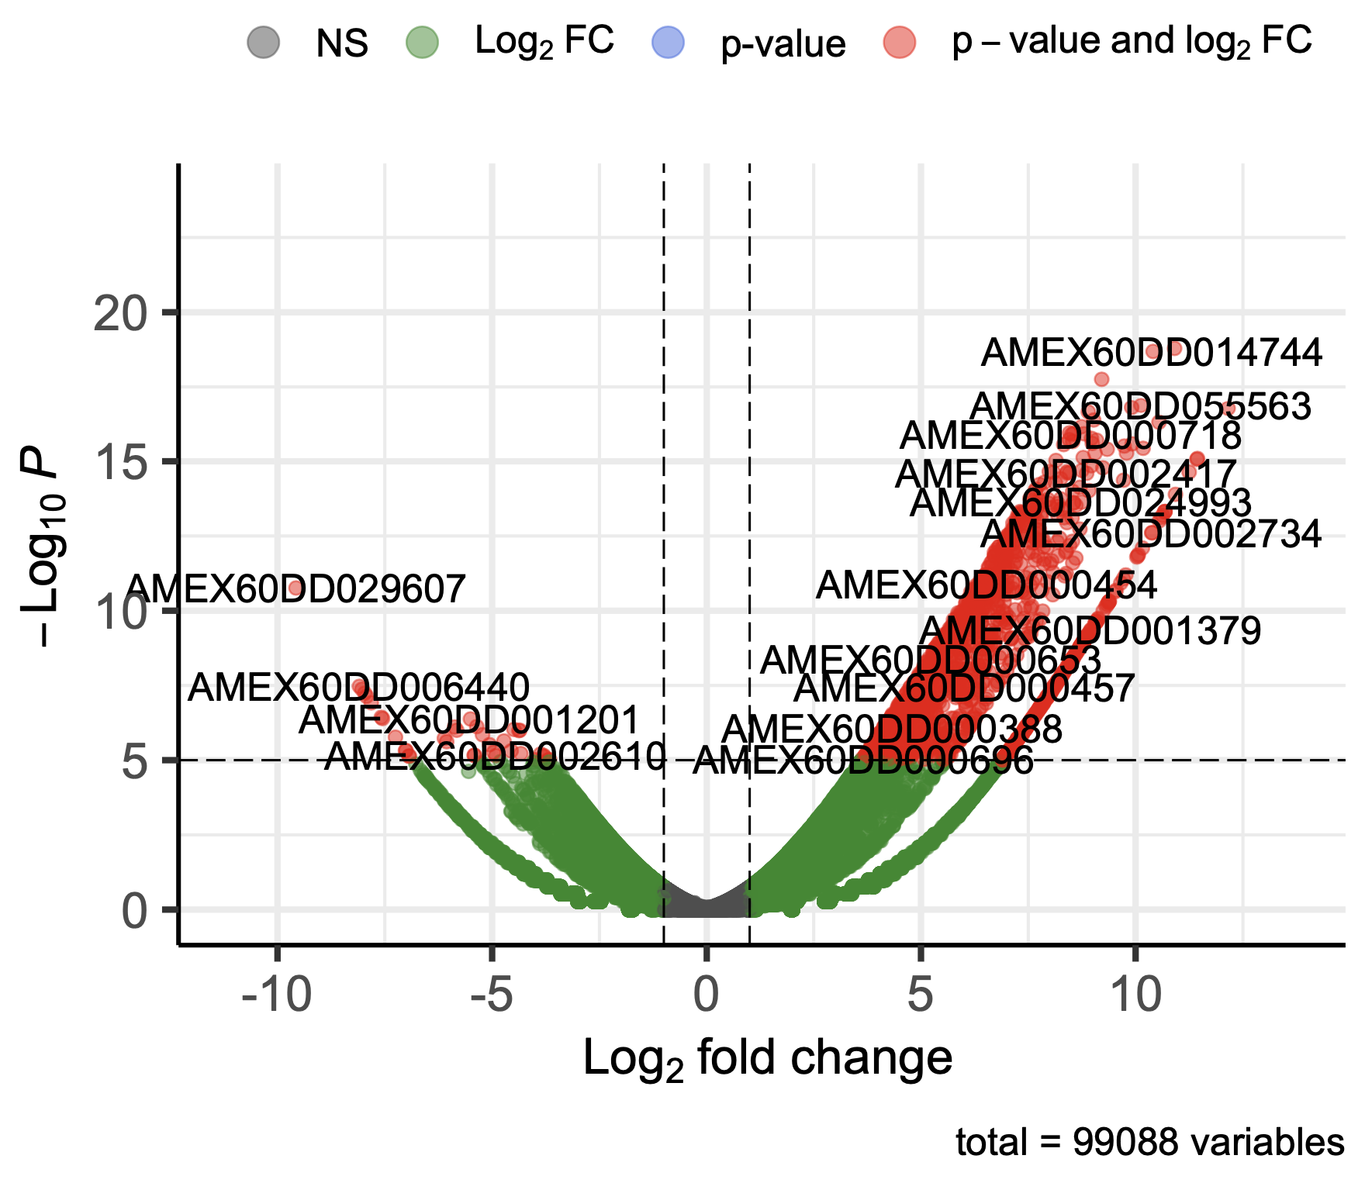
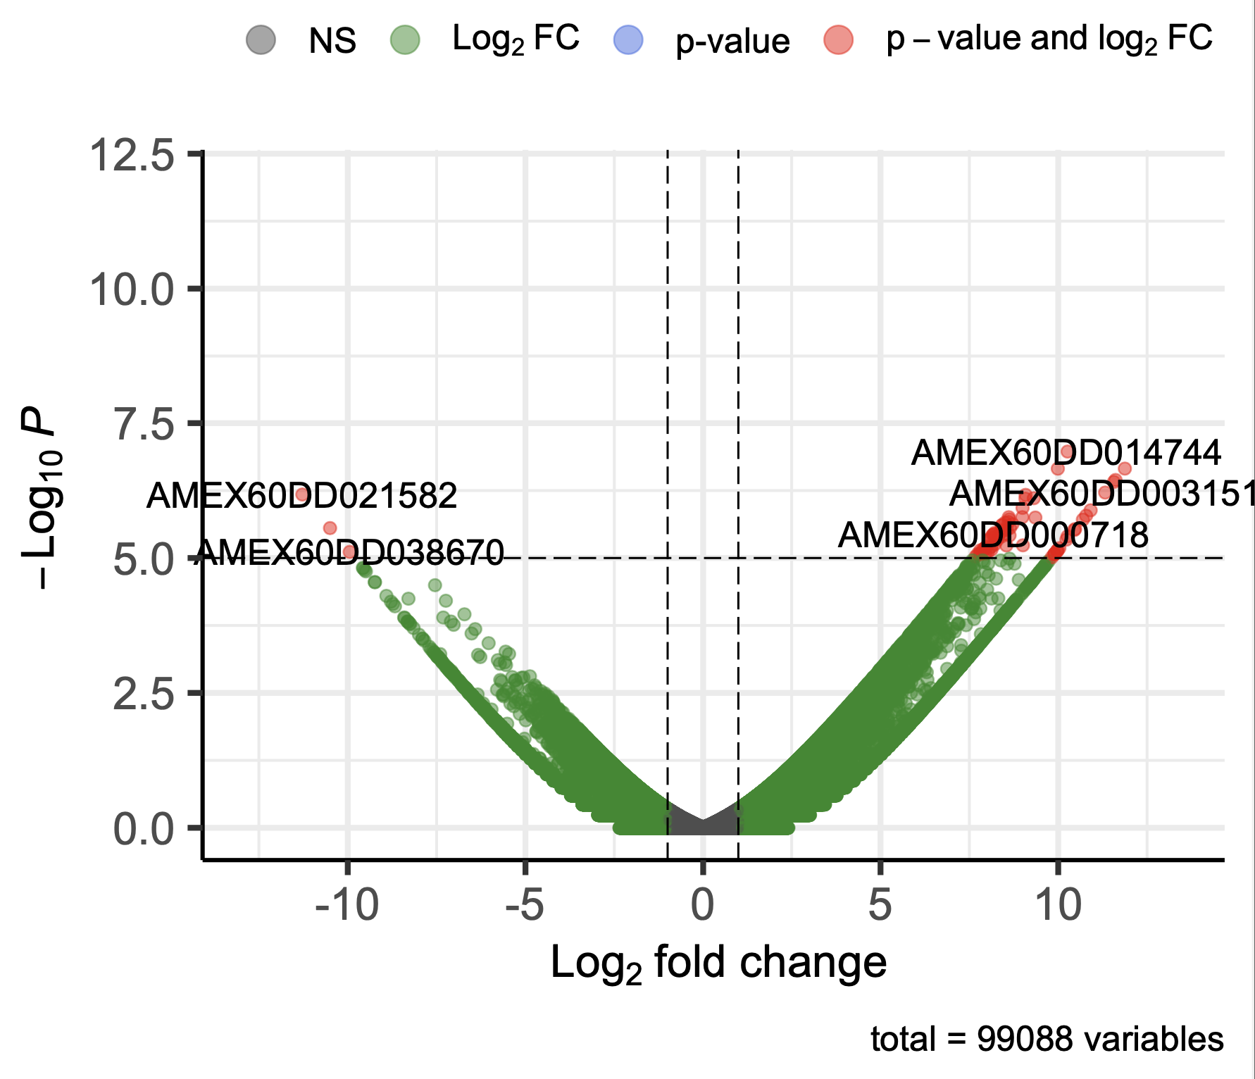
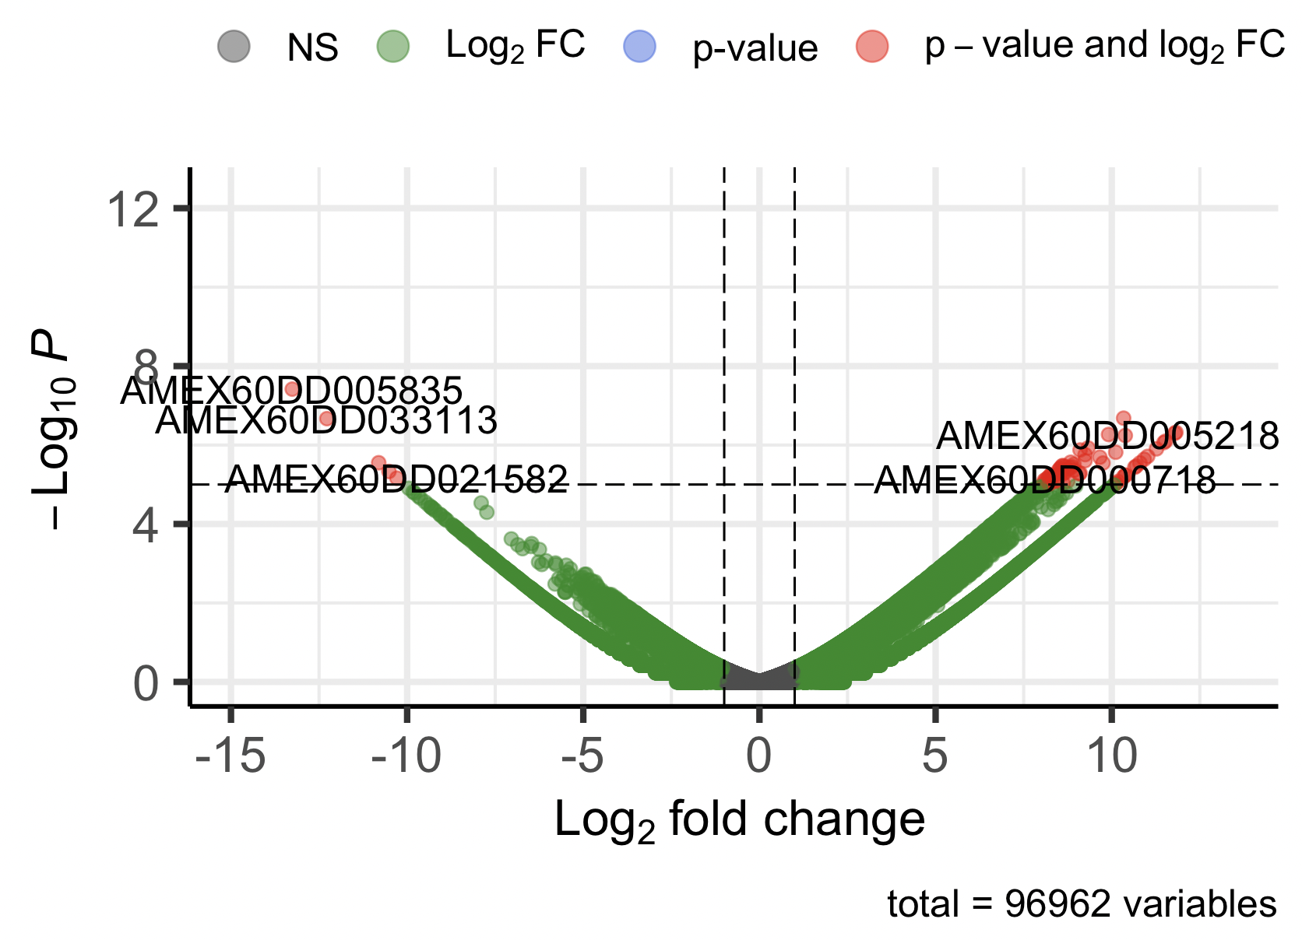
Differential Expression Analysis: DESeq2 and edgeR
STAR
Kallisto
SALMON
DESeq2
DESeq2
DESeq2
edgeR
edgeR
edgeR
2020 Transcriptome from axolotl-omics.org

Slide 6
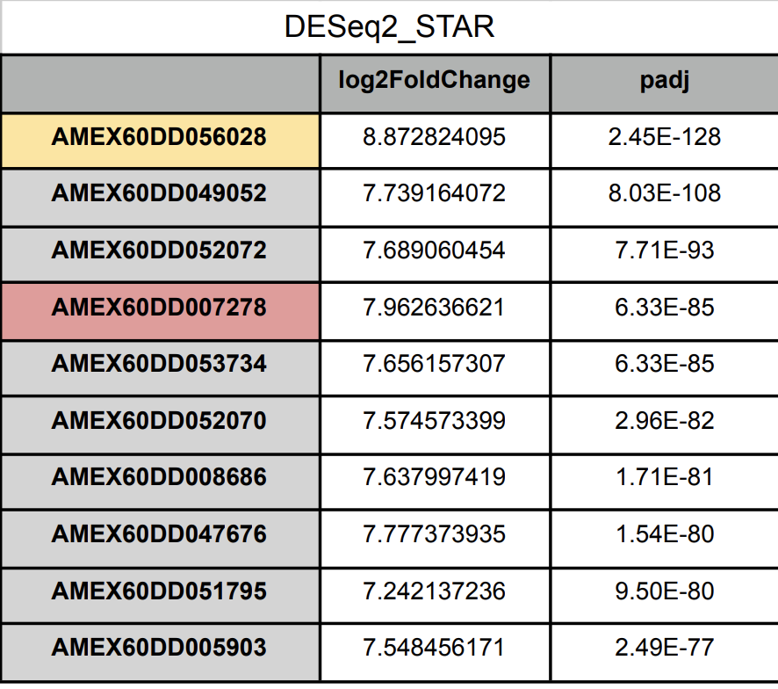
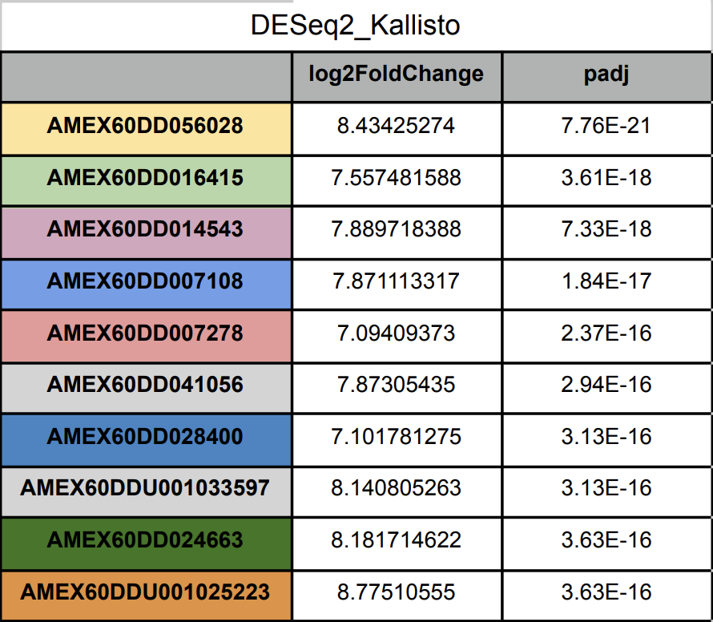
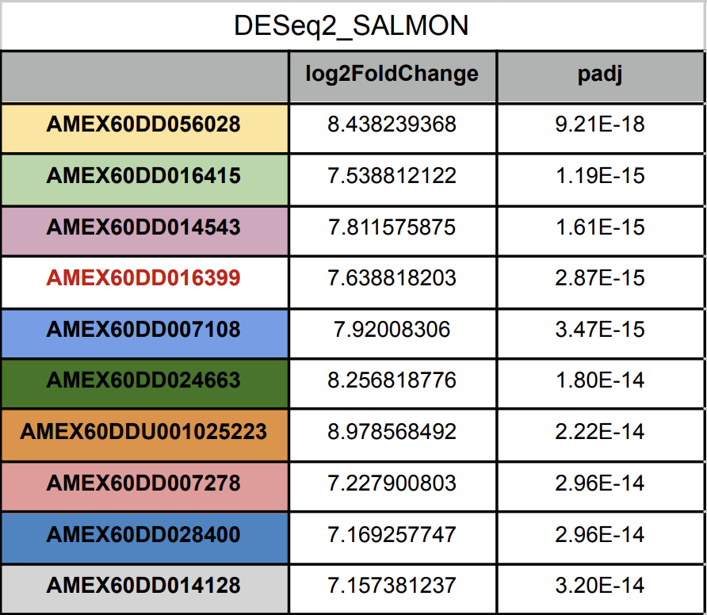
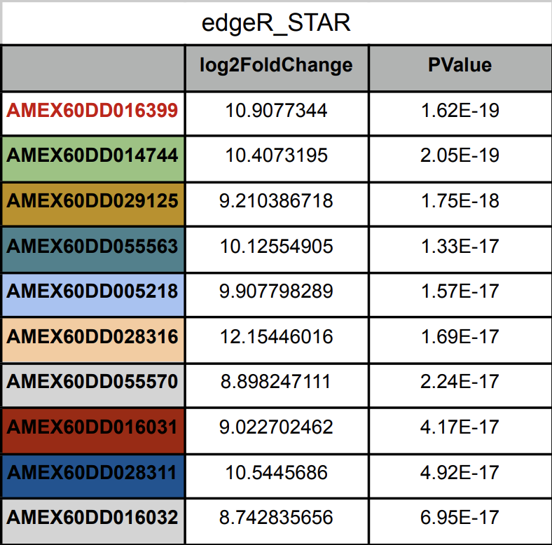
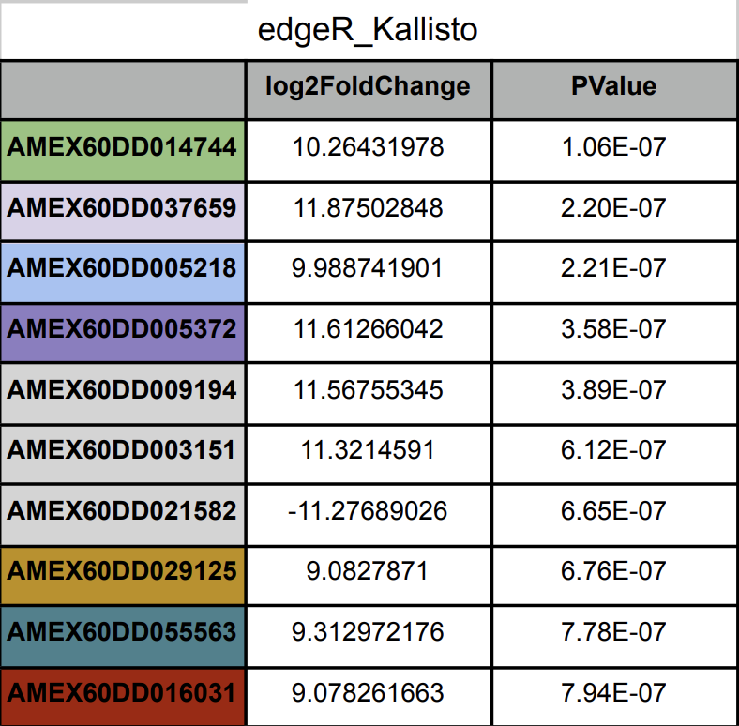
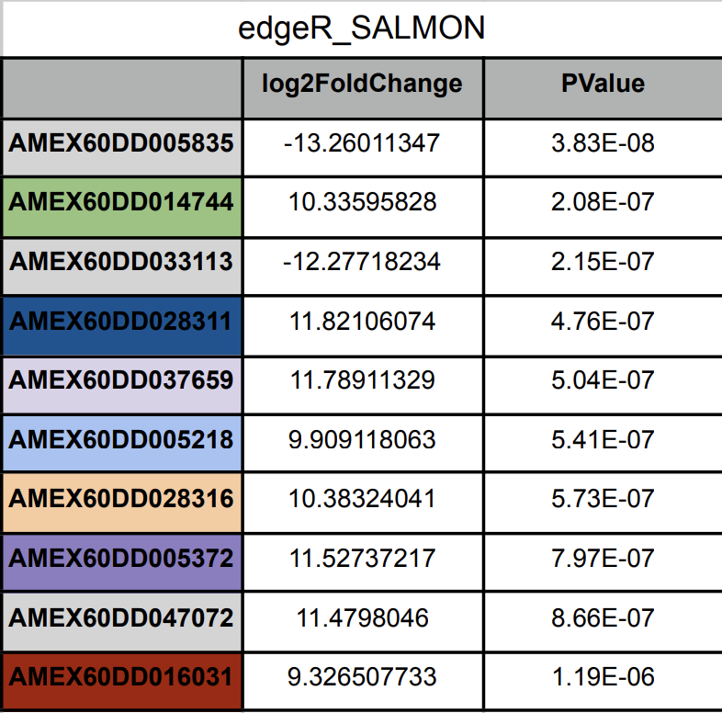
Top 10 differentially expressed genes
Notes:
AMEX60DD056028

Slide 7
qPCR Validation
Salmon | SRR16102732 | SRR16102729 | SRR16102717 | SRR16102730 | SRR16102727 | SRR16102718
Meis1 | 7 | 29 | 18 | 11 | 19 | 159
Enpp2 | 6672 | 3268 | 5441 | 489 | 729 | 572
Prod1 | 0 | 0 | 0 | 19 | 193 | 128
Hoxa11 | 1617 | 1352 | 1889 | 89 | 289 | 284
Epha7 | 253 | 165 | 167 | 0 | 35 | 45
Tig1 (Rarres1) | 184 | 68 | 245 | 2197 | 6803 | 2811
Hoxa13 | 3343 | 2482 | 3594 | 188 | 371 | 613
Lxh2 | 1245 | 1095 | 2084 | 85 | 146 | 204

Slide 8
Conclusions
Changes in gene expression between samples are consistent between transcript quantification tools
STAR+htseq, Kallisto, and Salmon are relatively consistent in their quantification of gene expression
There is a visible discrepancy between the results of edgeR and deseq2 for all quantification methods
qPCR validation from Oliveira et al. 2021 validate gene count results from our analysis
Larger samples sizes and further qPCR validation is necessary to determine the accuracy of or results

Slide 9
References
McCusker, C., Bryant, S. V. & Gardiner, D. M. The axolotl limb blastema: cellular and molecular mechanisms driving blastema formation and limb regeneration in tetrapods. Regeneration, https://doi.org/10.1002/reg2.32 (2015).
Oliveira, C. R., Knapp, D., Elewa, A., Gerber, T., Gonzalez Malagon, S. G., Gates, P. B., Walters, H. E., Petzold, A., Arce, H., Cordoba, R. C., Subramanian, E., Chara, O., Tanaka, E. M., Simon, A., &amp; Yun, M. H. TIG1 regulates proximo-distal identity during salamander limb regeneration. https://doi.org/10.1101/2021.02.03.428234 (2021).
Sibai, M., Parlayan, C., Tuğlu, P., Öztürk, G., &amp; Demircan, T. Integrative analysis of Axolotl Gene Expression Data from regenerative and wound healing limb tissues. https://doi.org/10.1101/693523 (2019).
Vieira, W. A. & McCusker, C. D. Hierarchical pattern formation during amphibian limb regeneration. Biosystems 183, 103989 (2019).

Slide 10
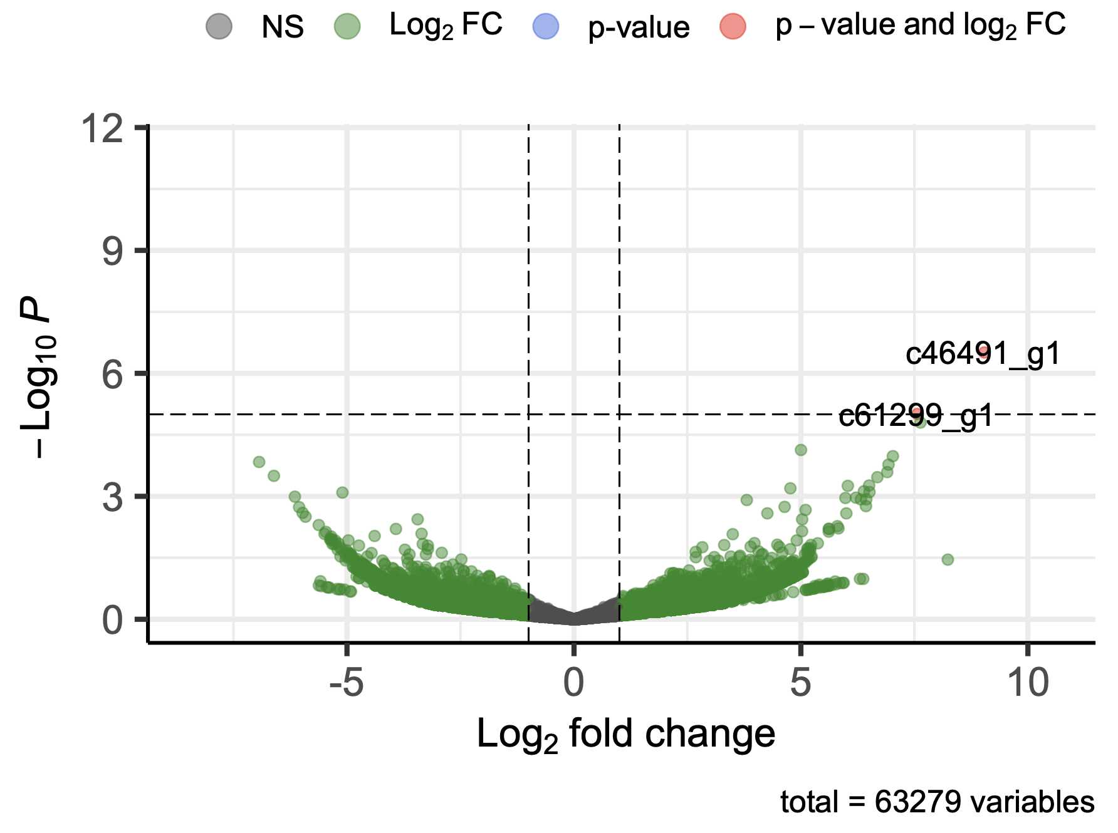
2017 Trinity de novo assembly transcriptome from Broad Institute

